Slide 1
Great Ideas Grants and MiNi Great Ideas Grants

Slide 2
Who may apply
All full or part-time teachers employed by the Helena School District are eligible to apply
Multiple educators may collaborate on projects – applications must be signed by all collaborating educators
All applications must be signed by the building administrator
Other partnering entities may not submit a grant proposal as the primary applicant.

Slide 3
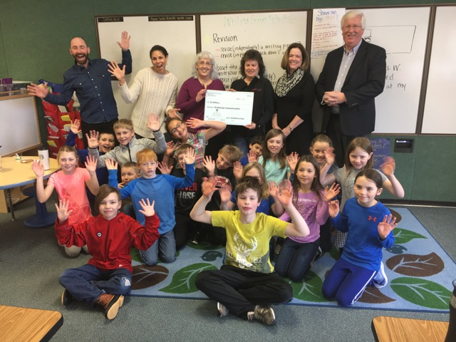

Slide 4
What: Great Ideas Grants
Great Ideas Grants:
$501-$1,250 for grants that are submitted by one educator
Up to $5,000 for grants submitted by two or more educators
2 grant cycles per year
Total of $40,000 awarded annually

Slide 5
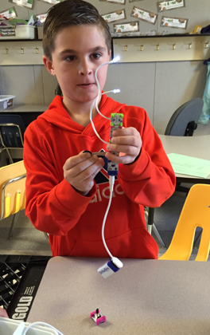
NEW: MiNi Great Ideas Grants
MiNi Great Ideas Grants:
Up to $500
4 grant cycles per year
Total of $5,000 awarded annually

Slide 6
APPLYING FOR A GRANT
Educators may apply for both a Great Ideas Grant and a MiNi Great Ideas Grant in the same grant cycle for different projects
Educators may not apply for both types in the same cycle for the same project.
Educators may apply for only 1 MiNi grant per cycle

Slide 7
Great Ideas Grants and MiNi Great Ideas Grants fund:
NEW projects only – not ongoing activities
Projects for which funding is not available from the HSD
Projects that are in-class or field trips
Projects that infuse new elements of creativity
Projects that extend learning beyond the limitations of the textbooks

Slide 8
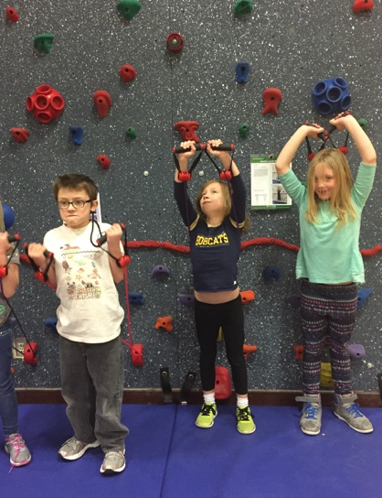

Slide 9
Grant funds may not be used for:
Monetary awards for students
District- provided textbooks and materials, technology, etc.
Workshops or professional development fees
Stipends for District employees
Substitute teachers during the working day unless teachers are with their class involved with the grant project

Slide 10
To Apply: Great Ideas Grants
Great Ideas Grants are due no later than Tuesday, October 6, by 5:00pm
Grants must be submitted in MSWORD format (personal information will be removed and any formatting issues be corrected by HEF staff prior to submission to the selection committee)
Choose a short title and brief summary of your project, including what the funds will purchase – the title and summary will be used for promotion if your grant is funded – see next slide for an example of a good title and summary
Note: grants are reviewed by a community representative committee – not educators, so please write your grant for an audience of community members.
For Great Ideas Grants, include
Cover Page
Signature Page
Summary page
Proposal

Slide 11
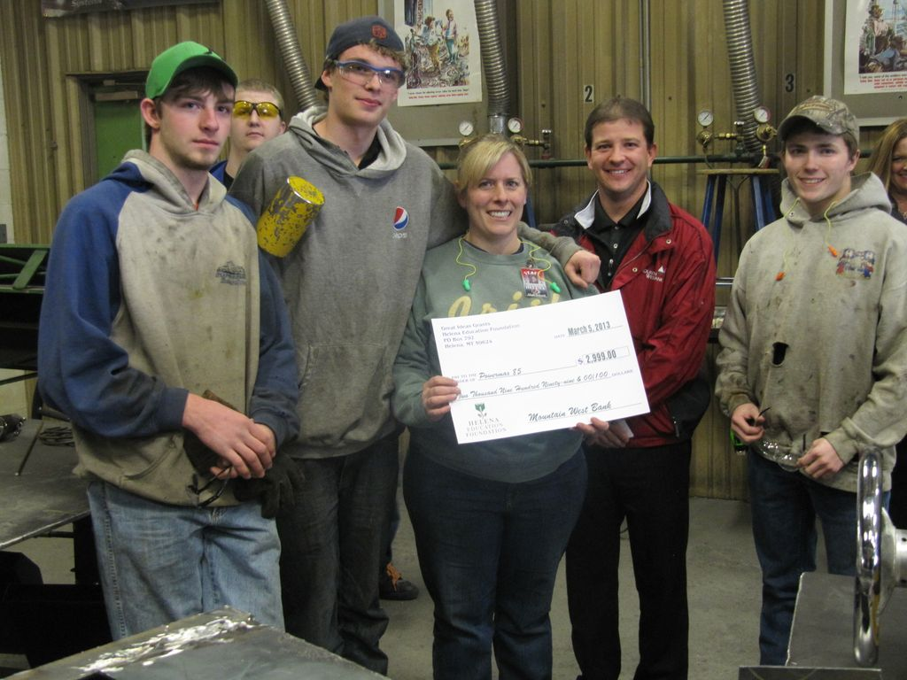
To Apply: MiNi Great Ideas Grants
MiNi Great Ideas Grants are due no later than Tuesday, September 29, by 5:00pm
MiNi Great Ideas Grants are reviewed internally by HEF

Slide 12
Sample Title and Summary Statements
ART SMART!
ART SMART resource kits are a collection of materials to help early elementary teachers teach meaningful fine art lessons in the classroom. ART SMART resource kits will be available for check out to all teachers in the district. Each kit provides books, toys, templates and art project ideas to make teaching dynamic art lessons a snap.
Climbing for Fitness
Through physical activity, we will engage and enhance students’ ability to work through problems and climb to greater heights. This grant will provide the funds to add the tools Everlast Full Start System and Starfit System to our existing traverse climbing wall to expand the impact of physical education for Jim Darcy students today and in the future.

Slide 13
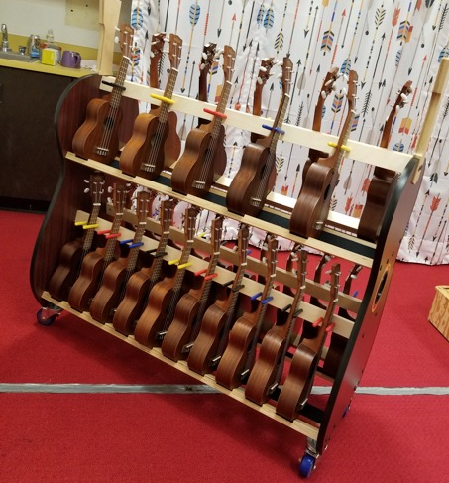
Project and application review
HEF staff are happy to discuss your grant project idea and offer feedback before you begin.
Email Lisa at hef@mt.net to arrange a phone call.
HEF staff are also happy to review draft grant applications and provide feedback for the final proposal if the draft application is received by Thursday October 1st by 5:00pm.
Email draft applications to Lisa at hef@mt.net

Slide 14
Budgets
Make sure your budget totals are added correctly
Purchases for successful grants will be made through the HSD
We encourage shopping locally when possible and can sometimes negotiate a similar deal with local merchants.

Slide 15
Important Links
More information, instructions, application form and sample past successful applications: Great Ideas Grants (due Oct. 6 by 5:00pm)
More information, instructions and application form: MiNi Great Ideas Grants (due Sept. 29 by 5:00pm)

Slide 16
QUESTIONS? We are happy to help!
email or call Lisa or Teresa at HEF
Helena Education Foundation
406.443.2545
hef@mt.net
www.hef@mt.org
P.O. Box 792
Helena 59624

